Slide 1
Construction of a DC machine:

Slide 2
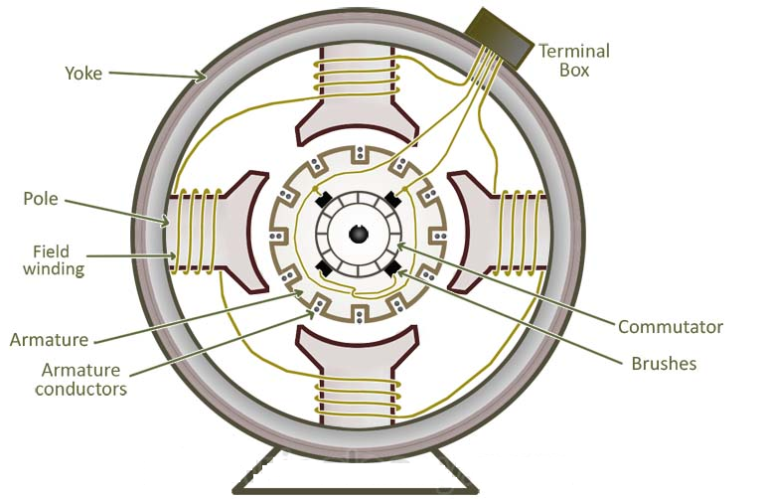
The main parts of DC generator are
Yoke
Poles and pole shoes
Field winding
Armature core
Armature winding
Commutator and brushes

Slide 3
Yoke: The outer frame of a dc machine is called as yoke. It is made up of cast iron or steel. It not only provides mechanical strength to the whole assembly but also carries the magnetic flux produced by the field winding
Poles and pole shoes: Poles are joined to the yoke with the help of bolts or welding. They carry field winding and. Pole shoes serve two purposes;
(i) they support field coils and (ii) spread out the flux in air gap uniformly.
Field winding: They are usually made of copper. Field coils are former wound and placed on each pole and are connected in series. They are wound in such a way that, when energized, they form alternate North and South poles.

Slide 4
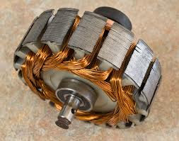
Armature core: Armature core is the rotor of a dc machine. It is cylindrical in shape with slots to carry armature winding. The armature is built up of thin laminated circular steel disks for reducing eddy current losses. It may be provided with air ducts for the axial air flow for cooling purposes.
Armature winding: It is usually a former wound copper coil which rests in armature slots. The armature conductors are insulated from each other and also from the armature core. Armature winding can be wound by one of the two methods; lap winding or wave winding. Double layer lap or wave windings are generally used. A double layer winding means that each armature slot will carry two different coils.

Slide 5
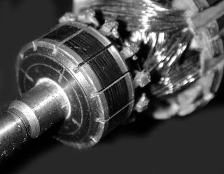
Commutator and brushes: Physical connection to the armature winding is made through a commutator-brush arrangement.
The function of a commutator, in a dc generator, is to collect the current generated in armature conductors.
A commutator consists of a set of copper segments which are insulated from each other. The number of segments is equal to the number of armature coils.
Each segment is connected to an armature coil and the commutator is keyed to the shaft.
Brushes are usually made from carbon or graphite. They rest on commutator segments and slide on the segments when the commutator rotates keeping the physical contact to collect or supply the current.

